Slide 1
Framework for Predicting Loan Default
Credit One

Slide 2
Framework Flowchart
Define the goal
Collect and Manage data
Build the model
Evaluate the model
Present the model results
Deploy and maintain the model
Exploratory Analysis

Slide 3
Goal Statements
Use potential borrower credit payment behaviors to predict whether or not the borrower will default on their loan in a 6 month period.
Credit One would use this output to inform credit scores provided to its various partners in order to significantly reduce the probability of approving customers who have a likelihood of defaulting on their loan

Slide 4
Data Collection / Data Management
Historical Data was provided by Guido Rossum, the Senior Data Scientist from Credit One
Data was stored online on the UCI Repository located https://archive.ics.uci.edu/ml/datasets/default+of+credit+card+clients
Binning (grouping data) will be completed for both the Amount Borrowed and the Age variables
This removes unnecessary noise and provides more training observations for categories with very limited observations.
See example using age where age 29 has 1,605 observations while ages 71 to 79 only have 15 observations combined
Amount borrowed will be binned appropriately using computer selected bins

Slide 5
Description of Data
Historical Data was provided by Guido Rossum, the Senior Data Scientist from Credit One
Data includes 30,000 unique customers and their credit repayment histories
Variable include:
Categorial – Gender, Education Level, Marital Status, Age, History of Past Payment
Numerical – Total Credit Given, Amount of bill statements, Amount of previous payments

Slide 6
Manual Data Changes
Data label for X6 History of Payment was labeled PAY_0, where X7 is PAY_2. This does not follow the pattern of X12 Bill Amount or X18 Payment Amount
X6 History of Payment will be relabeled to PAY_1
Education variable had four “other” categories, these were combined into one category (0, 4, 5, 6) = (4 = Other)

Slide 7
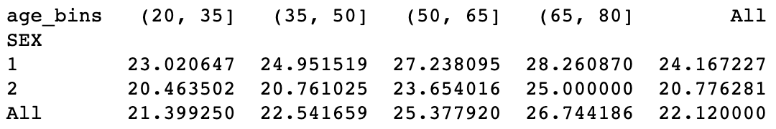
Exploratory Analysis
Data includes 6,636 observations where borrower defaulted on their loan and 23,364 that did not
Males defaulted 24% while Females defaulted 21% of the time
Males 51 and older default at 27%

Slide 8
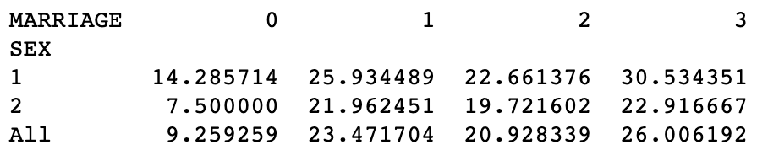
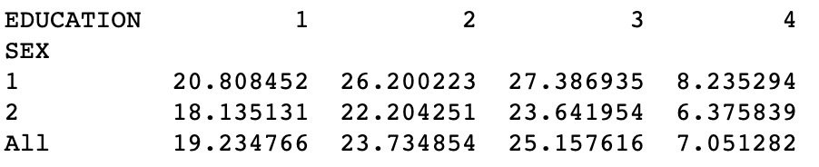
Exploratory Analysis -- Continued
Divorced borrowers have the highest default rate at 26%, with married next at 23.5%
Divorced Males default at 30.5%
Those with High School educations default at the highest rate at 25.2% High School Males default at 27.4%

Slide 9
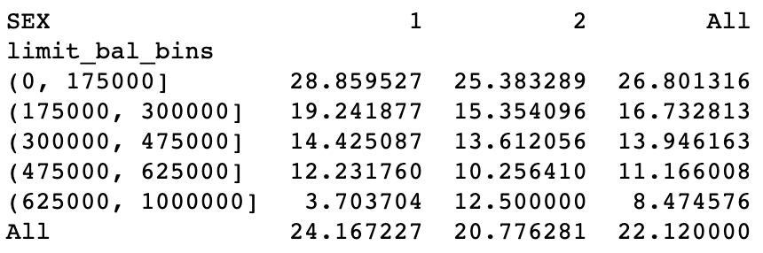
Exploratory Analysis -- Continued
Customers who borrow between 0 and $175K have the highest default rate at 26.8%,
Males have the highest rate at 28.9%

Slide 10
Exploratory Analysis Insight
Men default more than women 24% to 21%
High School graduates default at a higher rate 25.2%
Divorced customers default at the highest rate compared to single and married customers.
Those 50 and older default at a higher rate compared to other age groups
Caution should be taken when using these variables in determining loan approval. Discriminatory laws exist that prohibit loan approval based on gender, race, age and other comparable factors.

Slide 11
Model Building
Models tested in this analysis
Support Vector Machine (SVC)
TUNED
Random Forest (RF)
Logistic Regression (Lr)
Gradient Boosting (GB)
TUNED
Decision Tree (Tree)
K Nearest Neighbors (KNN)
Datasets used in this analysis
Out of Box
Correlation Removed - FS
Recursive Feature Elimination - RFE
Dummy Variables for all categorical variables
Correlation Removed - FS
Recursive Feature Elimination - RFE
Plus all datasets above scaled
12 total datasets

Slide 12
Model Evaluation – Top Performing for each model
Model | Dataset | Accuracy | KAPPA | ROC | Precision | Recall | F1 Score
SVC - Tuned | OOB / RFE / S | 0.821000 | 0.367036 | 0.653005 | 0.660019 | 0.356776 | 0.463179
RF | DV/ S | 0.817889 | 0.370893 | 0.658265 | 0.633305 | 0.376797 | 0.472481
Lr | DV / RFE / S | 0.817778 | 0.339301 | 0.637945 | 0.663482 | 0.320842 | 0.432526
GB - Tuned | OOB_FS_S_T | 0.823222 | 0.377115 | 0.657767 | 0.666978 | 0.366016 | 0.472655
Tree | OOB | 0.729667 | 0.234166 | 0.621847 | 0.388094 | 0.431725 | 0.408748
KNN | OOB_RFE_S | 0.777778 | 0.294241 | 0.636571 | 0.483355 | 0.387577 | 0.430199
BEST MODEL WAS THE GRADIENT BOOSTING MODEL USING OUT OF BOX FEATURE SELECTION SCALED

Slide 13
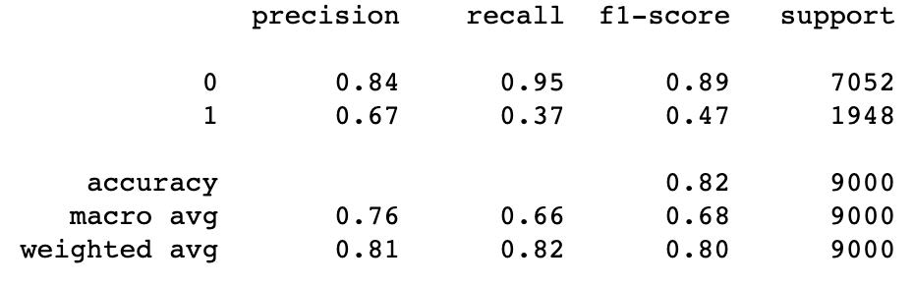
Top Model Performance
Model performed well in predicting the customers who did not default, the model did not perform as well in predicting the customers who did default

Slide 14
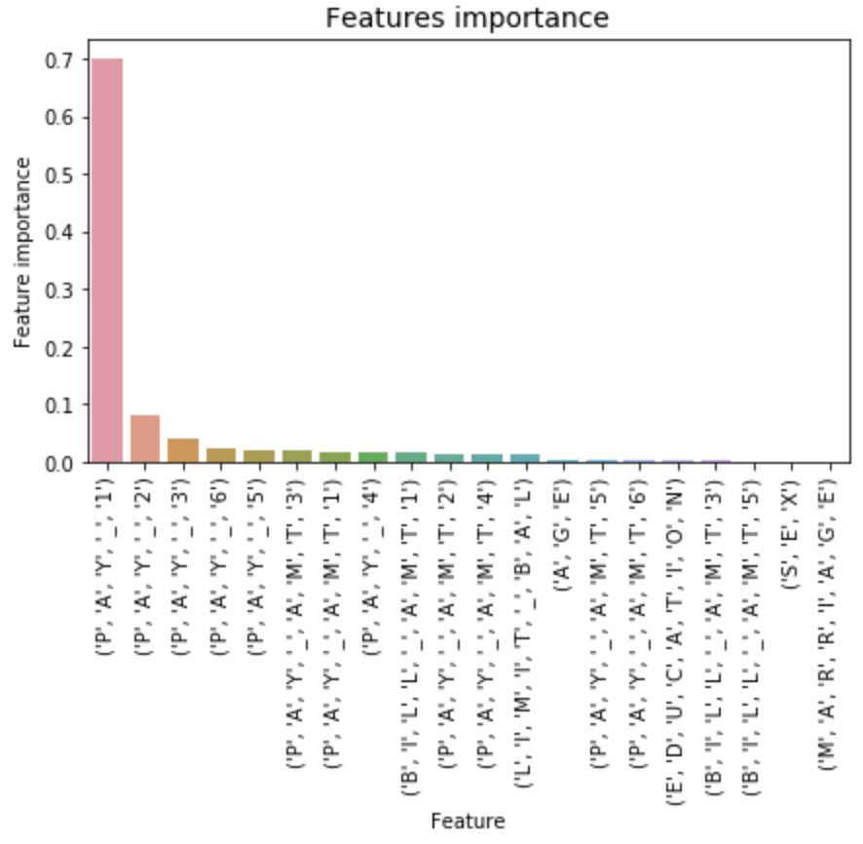
Variable Importance Top Model
Most important feature by far in this model is the PAY 1 variable
This is the most recent repayment status
The Pay variables show the most importance overall
Customer traits show little importance, with age being the first to show

Slide 15
Assessment
How do you ensure that customers will pay their loans?
This analysis cannot be used to ”ensure” that a customer will pay their loans. There is literally NO WAY to ever “ensure” that a member will pay their loan on time.
This analysis can be used to “predict” the probability that a customer will pay their loan on time.
This could be used to contact current customers who the model predicts might default, and provide assistance

Slide 16
Assessment - Continued
Can we approve customers with high certainty
The data analyzed in about customers with current loan information. These data did not include loan history data prior to approving a loan with Credit One.
Because of this, these data can only be used to predict whether current customers are going to default on their loan. It cannot be used to predict new customers without any data.

Slide 17
Further Study
Recommendation is to continue analyzing Credit One data to provide more data to the model. More specifically, the model need more default customers to further educate the model.
Recommend analyzing prior to acceptance data on our current customers to see if a model can be created to predict the likely hood of a customer defaulting after selection
Recommend adding “Credit Score” to the analysis and to the approval process

